Slide 1
Fetch Decode Execute Cycle

Slide 2
Fetch Decode Execute Cycle
The Von Neumann architecture uses a single processor which follows a linear sequence of fetch-decode-execute.
In order to do this, the processor has to use some special registers, which are discrete memory locations with special purposes attached. These are

Slide 3
Fetch Decode Execute Cycle
Register Meaning
PC Program Counter
CIR Current Instruction Register
MAR Memory Address Register
MDR Memory Data Register
IR Index Register
Accumulator Holds results

Slide 4
The program counter
The program counter keeps track of where to find the next instruction so that a copy of the instruction can be placed in the current instruction register.
Sometimes the program counter is called the Sequence Control Register (SCR) as it controls the sequence in which instructions are executed.

Slide 5
The current instruction register
The current instruction register holds the instruction that is to be executed.

Slide 6
The memory address register
The memory address register is used to hold the memory address that contains either the next piece of data or an instruction that is to be used.

Slide 7
The memory data register
The memory data register acts like a buffer and holds anything that is copied from the memory ready for the processor to use it.

Slide 8
The central processor
The central processor contains the arithmetic-logic unit (also known as the arithmetic unit) and the control unit.
The arithmetic-logic unit (ALU) is where data is processed.
This involves arithmetic and logical operations.

Slide 9
The central processor
Arithmetic operations are those that add and subtract numbers, and so on.
Logical operations involve comparing binary patterns and making decisions.

Slide 10
The control unit
The control unit fetches instructions from memory, decodes them and synchronises the operations before sending signals to other parts of the computer.

Slide 11
The accumulator
The accumulator is in the arithmetic unit, the program counter and the instruction registers are in the control unit and the memory data register and memory address register are in the processor.

Slide 12
An index register
An index register is a microprocessor register used for modifying operand addresses during the run of a program.
Index registers are used for a special kind of indirect addressing where an immediate constant is added to the contents of the index register to form the address to the actual operand or data.

Slide 13
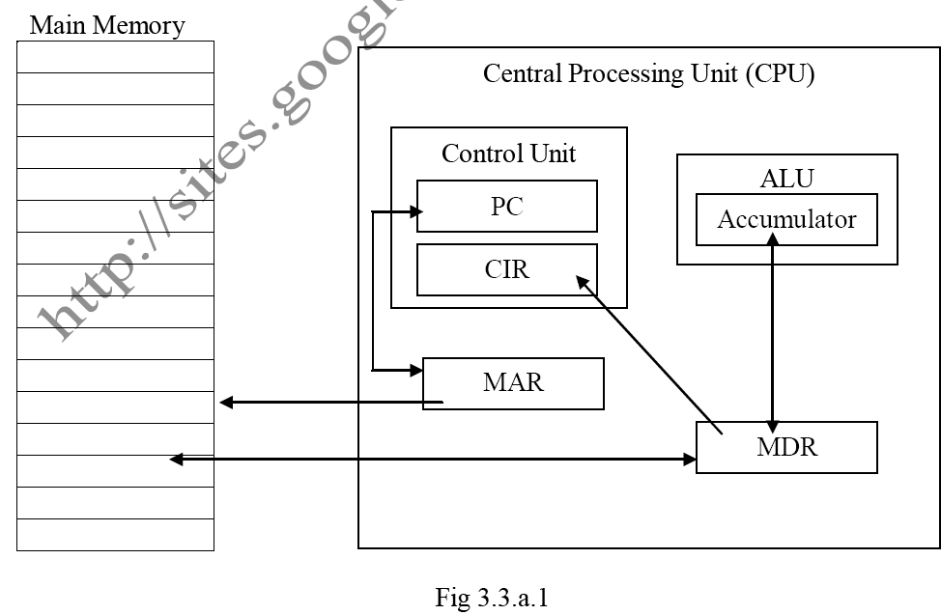
Typical Layout

Slide 14
The Fetch-Decode-Execute-Reset Cycle
The following is an algorithm that shows the steps in the cycle. At the end the cycle is reset and the algorithm repeated.
1. Load the address that is in the program counter (PC) into the memory address register (MAR).
2. Increment the PC by 1.

Slide 15
The Fetch-Decode-Execute-Reset Cycle
3. Load the instruction that is in the memory address given by the MAR into the memory data register (MDR).
4. Load the instruction that is now in the MDR into the current instruction register (CIR).
5. Decode the instruction that is in the CIR.

Slide 16
The Fetch-Decode-Execute-Reset Cycle
6. If the instruction is a jump instruction then
a. Load the address part of the instruction into the PC
b. Reset by going to step 1.
7. Execute the instruction.
8. Reset by going to step 1.

Slide 17
Explanation
Steps 1 to 4 are the fetch part of the cycle.
Steps 5, 6a and 7 are the execute part of the cycle and steps 6b and 8 are the reset part.
Step 1 simply places the address of the next instruction into the memory address register so that the control unit can fetch the instruction from the right part of the memory.

Slide 18
Explanation
The program counter is then incremented by 1 so that it contains the address of the next instruction, assuming that the instructions are in consecutive locations.

Slide 19
Explanation
The memory data register is used whenever anything is to go from the central processing unit to main memory, or vice versa.
Thus the next instruction is copied from memory into the MDR and is then copied into the current instruction register.

Slide 20
Explanation
Now that the instruction has been fetched the control unit can decode it and decide what has to be done.
This is the execute part of the cycle. If it is an arithmetic instruction, this can be executed and the cycle restarted as the PC contains the address of the next instruction in order.

Slide 21
Explanation
However, if the instruction involves jumping to an instruction that is not the next one in order, the PC has to be loaded with the address of the instruction that is to be executed next.
This address is in the address part of the current instruction, hence the address part is loaded into the PC before the cycle is reset and starts all over again.

Slide 22
Explanation
A CPU cannot do math on data registers, although it can do it indirectly with an index register.
The index register works with the data registers, allowing a program to process strings of data efficiently.
To process your first name, for example, a program move 300 to MAR and zero to the index register.

Slide 23
Explanation
An indexed operation adds the index value to the MDR, retrieving the letter at location 300.
Next, the program increments the index by one and gets the next letter.
It repeats this process until it has moved the whole name.
By itself, the index register does little; its value is that it gives greater speed and convenience to address registers.

Slide 24
The need for and the use of buses to convey data (Data, Address and Control Buses)
A bus is a set of parallel wires connecting two or more components of the computer.
The CPU is connected to main memory by three separate buses.
When the CPU wishes to access a particular memory location, it sends this address to memory on the address bus.

Slide 25
Buses
The data in that location is then returned to the CPU on the data bus. Control signals are sent along the control bus.
The data, address and control buses connect the processor, memory and I/O controllers. These are all system buses.

Slide 26
Buses
Each bus is a shared transmission medium, so that only one device can transmit along a bus at any one time.
Data and control signals travel in both directions between the processor, memory and I/O controllers.

Slide 27
Buses
Address, on the other hand, travel only one way along the address bus: the processor sends the address of an instruction, or of data to be stored or retrieved, to memory to an I/O controller.

Slide 28
Buses
The control bus is a bi-directional bus meaning that signals can be carried in both directions.
The data and address buses are shared by all components of the system.
Control lines must therefore be provided to ensure that access to and use of the data and address buses by the different components of the system does not lead to conflict.

Slide 29
Buses
The purpose of the control bus is to transmit command, timing and specific status information between system components.
Timing signals indicate the validity of data and address information.
Command signals specify operations to be performed.

Slide 30
Buses
Specific status signals indicate the state of a data transfer request, or the status of request by a components to gain control of the system bus.

Slide 31
Data Bus
The data bus, typically consisting of 8, 16, or 32 separate lines provides a bi-directional path for moving data and instructions between system components.
The width of the data bus is a key factor in determining overall system performance.

Slide 32
Data Bus
For example, if the data bus is 8 bits wide, and each instruction is 16 bits long, then the processor must access the main memory twice during each instruction cycle.

Slide 33
Address bus
: When the processor wishes to read a word (say 8, 16, or 32 bits) of data from memory, it first puts the address of the desired word on the address bus.
The width of the address bus determines the maximum possible memory capacity of the system.

Slide 34
Address Bus
For example, if the address bus consisted of only 8 lines, then the maximum address it could transmit would be (in binary) 11111111 or 255 – giving a maximum memory capacity of 256 (including address 0).
A more realistic minimum bus width would be 20 lines, giving a memory capacity of 1Mb.

Slide 35
Decoding
Assuming it is a 16 bit instruction and 4 bits are opcode, do the following:
Copy the right most 12 bits into MAR
Decode the left most 4 bits to determine the opcode
MAR <- IR[11 – 0] and decode [15 – 11]
If necessary use the address in MAR to go to memory location to get data, placing

Slide 36
Decoding
The data in MDR and then execute the instruction
MDR <- M[MAR] and execute the actual instruction

